Slide 1
IFS simulations update
Maxime Rizzo, Neil Zimmerman
Goddard IFS Lab
WFIRST Sims telecon
June 2nd, 2017

Slide 2
Outline
Impact of interpolation noise on RDI post-processing gain in the IFS
Updates on SNR calculations in the IFS

Slide 3
Approach
Use John Krist OS5 inputs
Oversampled reference star, target star and offaxis PSFs
Time series: 30ks on ref, 100ks on target
Propagate full time series through IFS using CRISPY, the Goddard IFS simulator, obtain average detector maps
Reduce maps into IFS cubes
Subtract reference from target slice-by-slice (RDI)
Convolve with matched filter to determine noise map

Slide 4

Approach
Repeat for case where input is shifted by equivalent of 0.5 lenslets in both X and Y (worst interpolation case)
Repeat for different lenslet sampling cases
Contrast gain = $\frac{\text{STD}\text{(}\text{convolved} \text{RDI} \text{map}\text{) }}{\text{STD}\text{(}\text{convolved} \text{reference} \text{star} \text{map}\text{)}}$

Slide 5
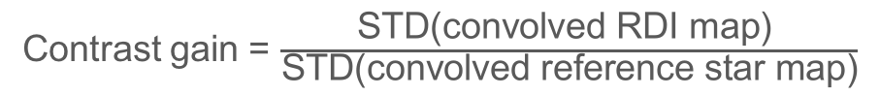
Wavelength-dependent contrast gain
Contrast gain = $\frac{\text{STD}\text{(}\text{convolved} \text{RDI} \text{map}\text{) }}{\text{STD}\text{(}\text{convolved} \text{reference} \text{star} \text{map}\text{)}}$

Slide 6
2.0 lenslets per lam/D at 660nm

Slide 7
2.2 lenslets per lam/D at 660nm

Slide 8
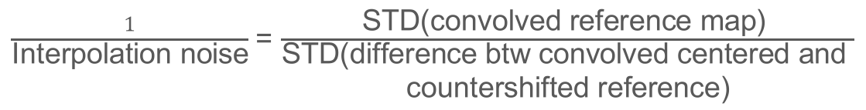
Interpolation noise
$\frac{1}{\text{Interpolation} \text{noise}}$ = $\frac{\text{STD}\text{(}\text{convolved} \text{reference} \text{map}\text{) }}{\begin{aligned}\text{STD}\text{(}\text{difference} \text{btw} \text{convolved} \text{centered} \text{and} \\ \text{countershifted} \text{reference}\text{)}\end{aligned}}$

Slide 9
Realistic IFS cube models
Goals:
OS5 simulations for the IFS
Incorporate all sources of noise
Verify Bijan’s SNR estimates
Simulate 47 Uma c, do RDI, and look at extracted flux
Produce realistic IFS detector maps and reduced IFS cubes

Slide 10
Recovered spectrum in noiseless data
IFS cube reconstruction algorithm: ‘optimal’ extraction (Horne+1986)
For more info on the reduction algorithm, see Brandt+2017, submitted

Slide 11
Noisy IFS detector map
~27 hours exposure

Slide 12
IFS cubes
Noise includes:
Dark current
CIC
Electron multiplying noise
Poisson
Loss of QE due to traps capture (no release yet)

Slide 13
Convolution with matched filter

Slide 14
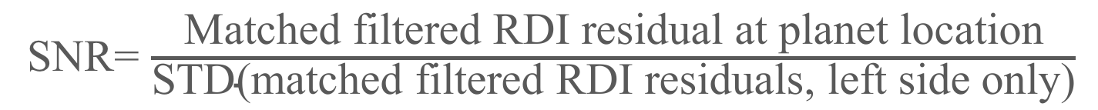
Future improvements
Need to perfect RDI on noisy data
Right now, some systematic over-subtraction of the planet flux
Need to add some sources of noise:
Zodiacal/exozodiacal light
Traps release mechanism (that’s hard to do right)
Need to verify absolute photon counts with Bijan
Need to agree on SNR metric for discussion
SNR= $\frac{ \text{Matched} \text{filtered} \text{RDI} \text{residual} \text{at} \text{planet} \text{location} }{\text{STD}\text{(}\text{matched} \text{filtered} \text{RDI} \text{residuals}\text{, }\text{left} \text{side} \text{only}\text{)}}$

